Slide 1



Lab09架構分享
林恆霈

Slide 2


行业PPT模板http://www.1ppt.com/hangye/
CONTENTS
01
Architecture
02
Beverage
03
Bridge
04
Latency

Slide 3




Part 01
Architecture

Slide 4


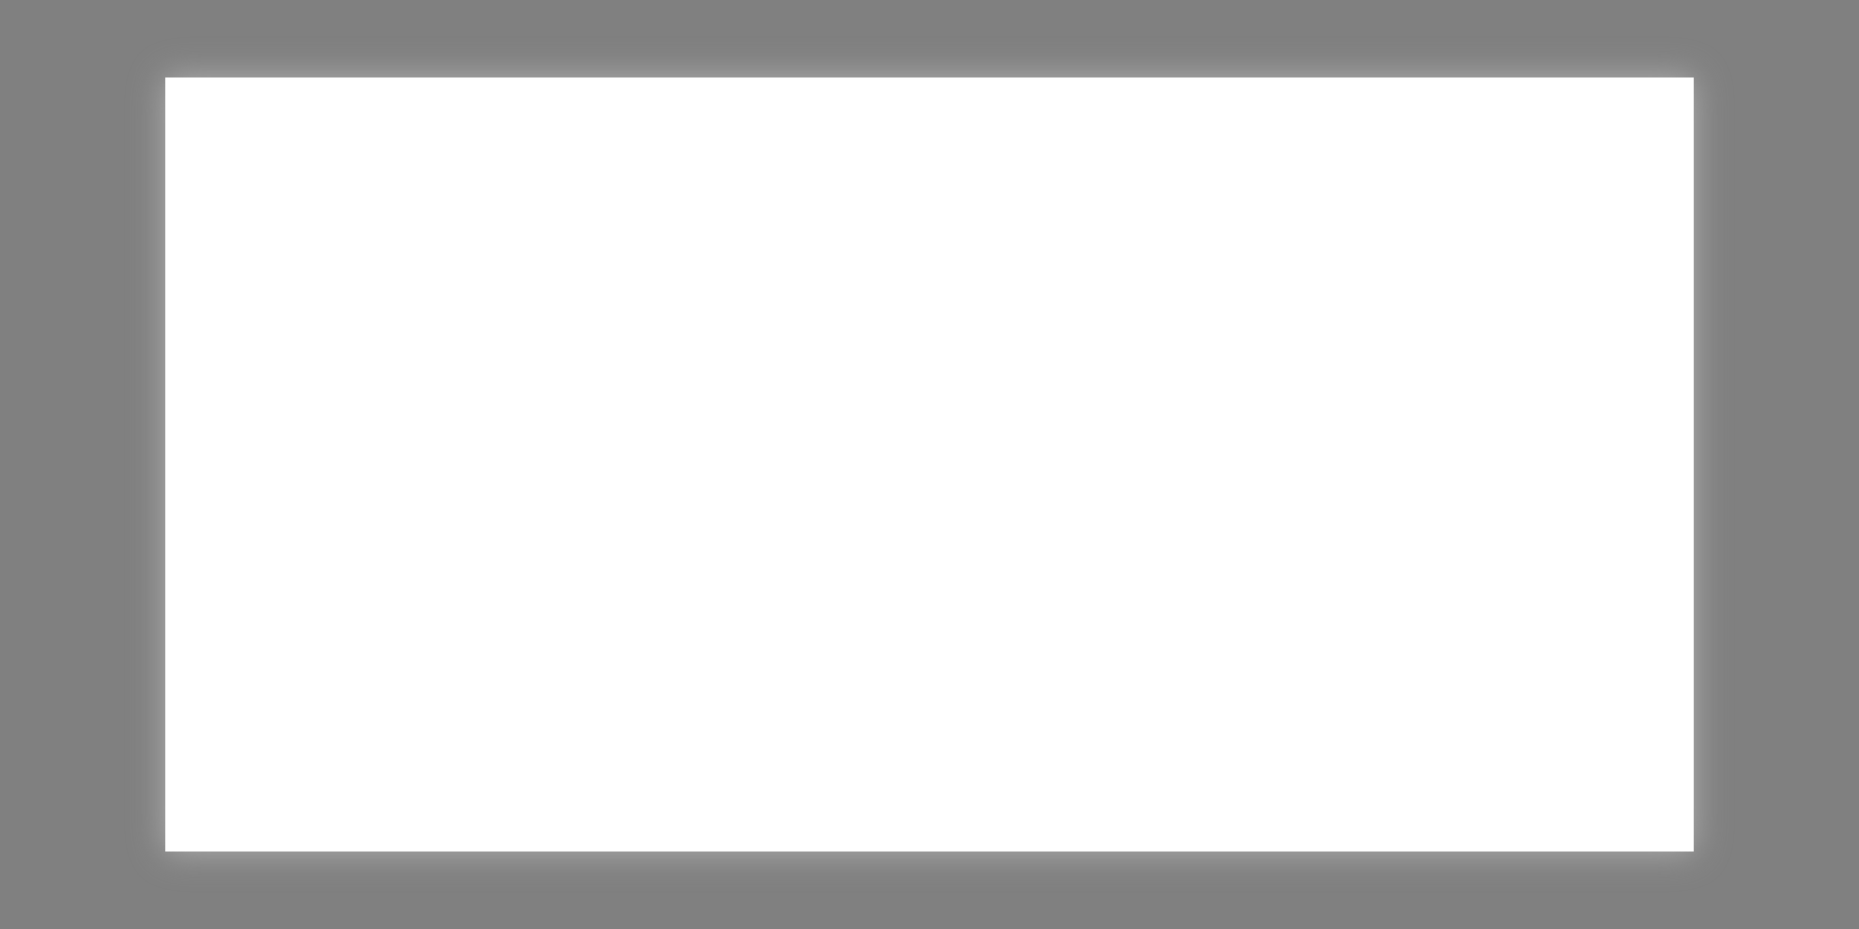
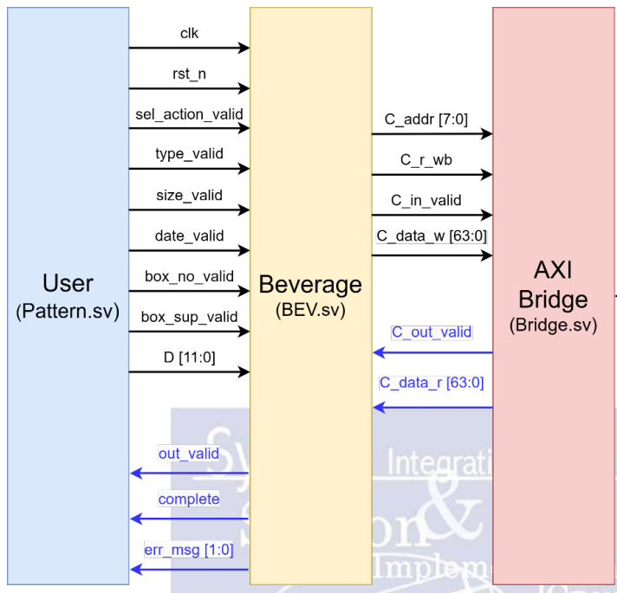
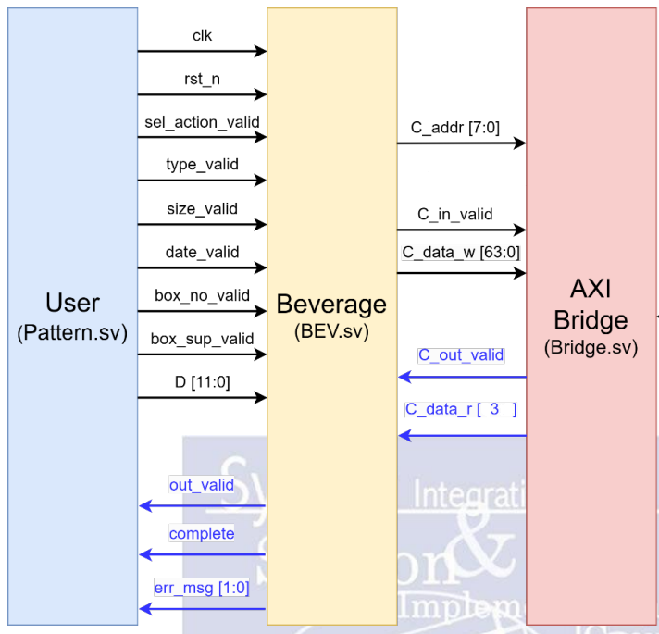
Architecture
1 . Check Date , Ingredient and Overflow in Bridge.sv
2. C_data_r [1:0] transmits err_msg

Slide 5
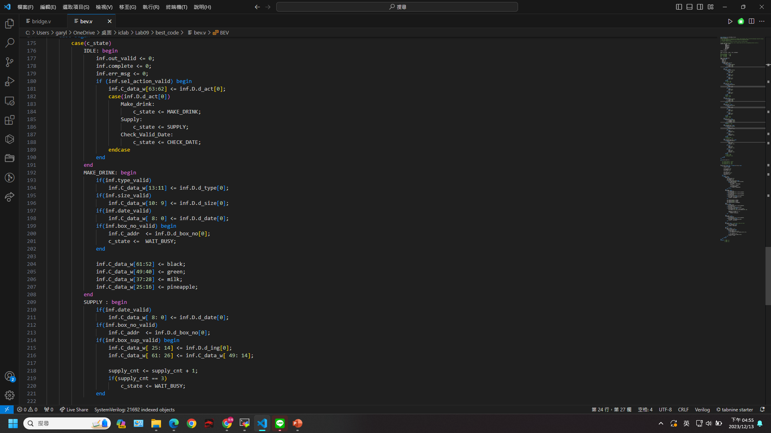
Beverage
1 . Save all information in C_data_w
C_data_w[63:62] : Action
C_data_w[13:11] : Type
C_data_w[10: 9] : Size
C_data_w[ 8: 0] : Date
C_data_w[61:50] : Black tea ingredient
C_data_w[49:38] : Green tea ingredient
C_data_w[37:26] : Milk ingredient
C_data_w[25:14] : Pineapple ingredient

Slide 6
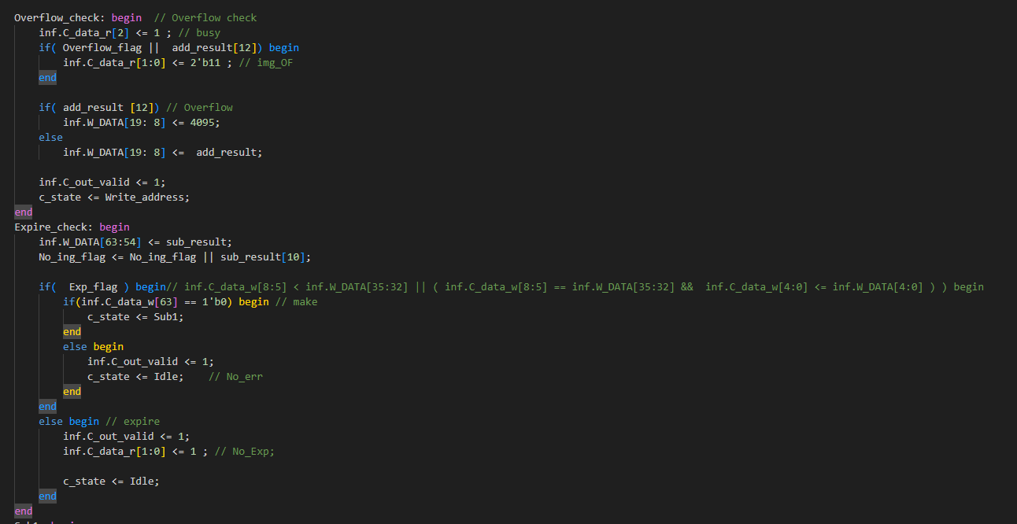
Bridge
1 . Read , Write dram
2 . Check err_msg
3. Using one adder (12 bits) one subtractor (10 bits)
4. C_data_r [2] : busy
C_data_r [1:0] : err_msg

Slide 7
Part 02
Latency

Slide 8
Action
Make Drink | Supply | Check expired date
Read dram | Read dram | Read dram
check expired date | Add | check expired date
Subtract | check overflow
check ingredient
Write dram | Write dram
Busy = 0
Output err_msg !!
Busy = 1

Slide 9
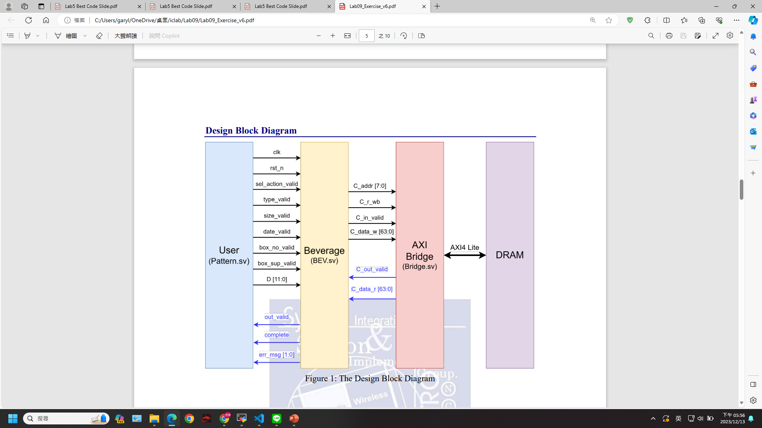
Busy : 1
data_r[1:0]
Write

Slide 10
Busy : 1
Write
err_msg

Slide 11
Next input
Busy : 1
Write

Slide 12
Read
Busy : 0

Slide 13
Performance
Beverage : 9236
Bridge : 18158
Cycle time : 2.2 ns

Slide 14
Thank you

